Slide 1



Presentation VII
Literature Review
Thu Ta Zaw
2415121095

Slide 2

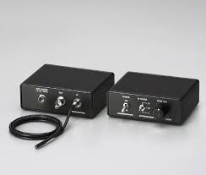
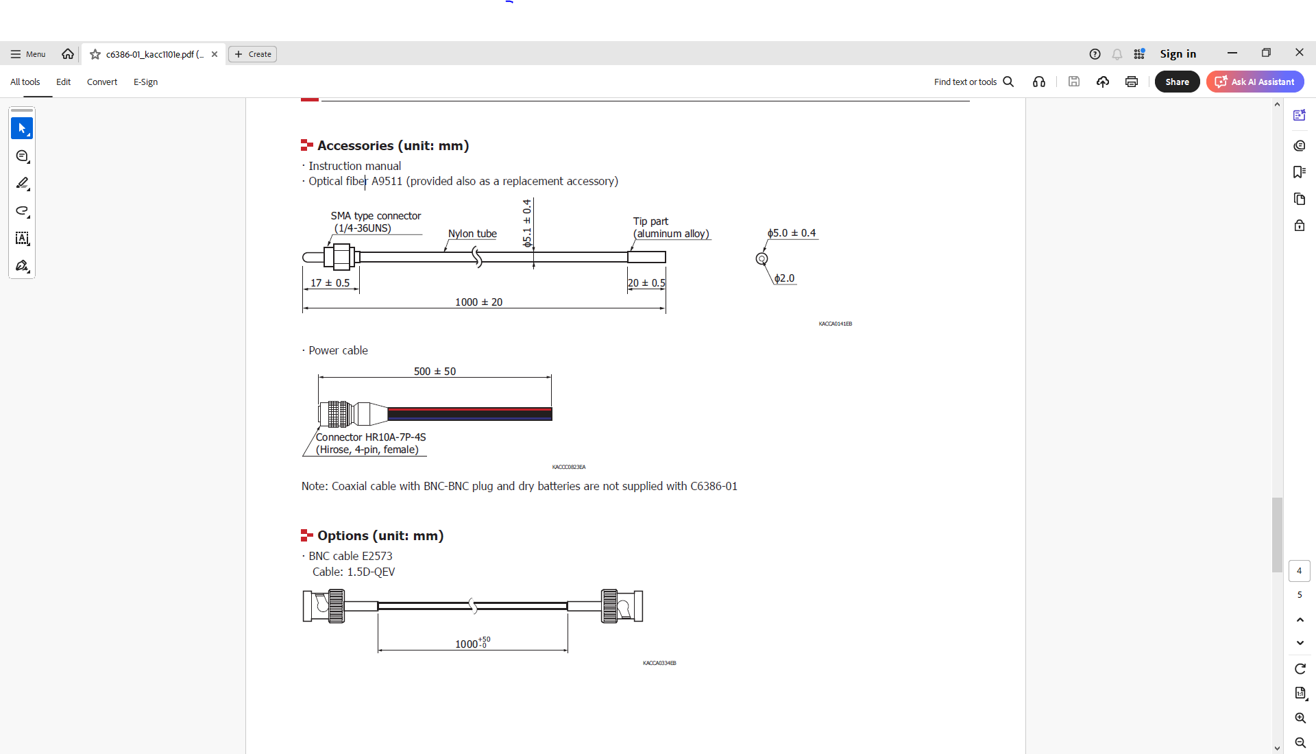
Light Detector
Hamamatsu C6386-01
Light to voltage conversion amplifier with optical fiber.
Price : 94,500 yen.
Required Interfacing with RPI 5. (LabJack U3-HV 37,789 yen).
BNC cable : 3,460 yen.
Can only interface with Oscilloscope.
Fig. Hamamatsu C6386-01.
Fig. Optical Fiber A9511
Fig. BNC-R cable
Fig. Power Cable

Slide 3
Literature Review
Advance Glycation End Product (AGE). Characterization of the products from reaction between D. Glucose and Serum Albumin
The objective of this research is to study how AGEs form from the reaction between D-glucose and bovine serum albumin (BSA), and to characterize these products using biochemical and spectroscopic methods.
Since AGEs accumulate during aging and diabetes, altering proteins such as collagen, elastin and myelin, it is importance to characterize.
Use Fluorescence Spectroscopy to track the AGE formation.
Fructosamine Assay to quantify early glycation products (Amadori compounds), which is intermediates formed before AGEs.
Applied multiple types of chromatography to isolate and characterize AGE fractions
PAGE and SDS-PAGE to visualize protein size changes, cross-linking, and change heterogeneity.

Slide 4
Literature Review
Fluorescence Spectroscopy
The purpose of performing fluorescence spectroscopy is to detect and quantify AGE formation over time based on their characteristic fluorescence.
Samples of incubation mixture (BSA + glucose) and control (BSA without glucose) were measured under identical conditions.
Fluorescence appeared after only 3 days, indicating early AGE formation, and its intensity increased steadily with incubation time.
Larger AGE aggregates showed higher fluorescence, linking fluorescence strength to molecular size.
AGEs exhibits a specific intrinsic fluorescence with the excitation wavelength of 370 nm and Emission wavelength of 440nm.

Slide 5
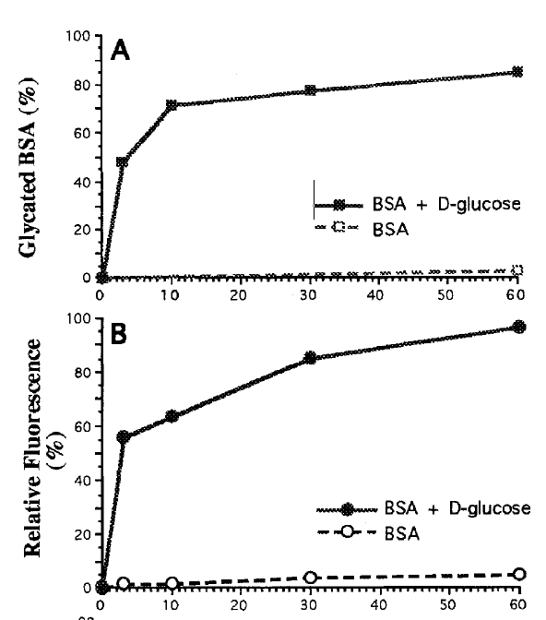
Literature Review
Fig. Glycated BSA (%) and Relative fluorescence (%) vs incubation time

Slide 6
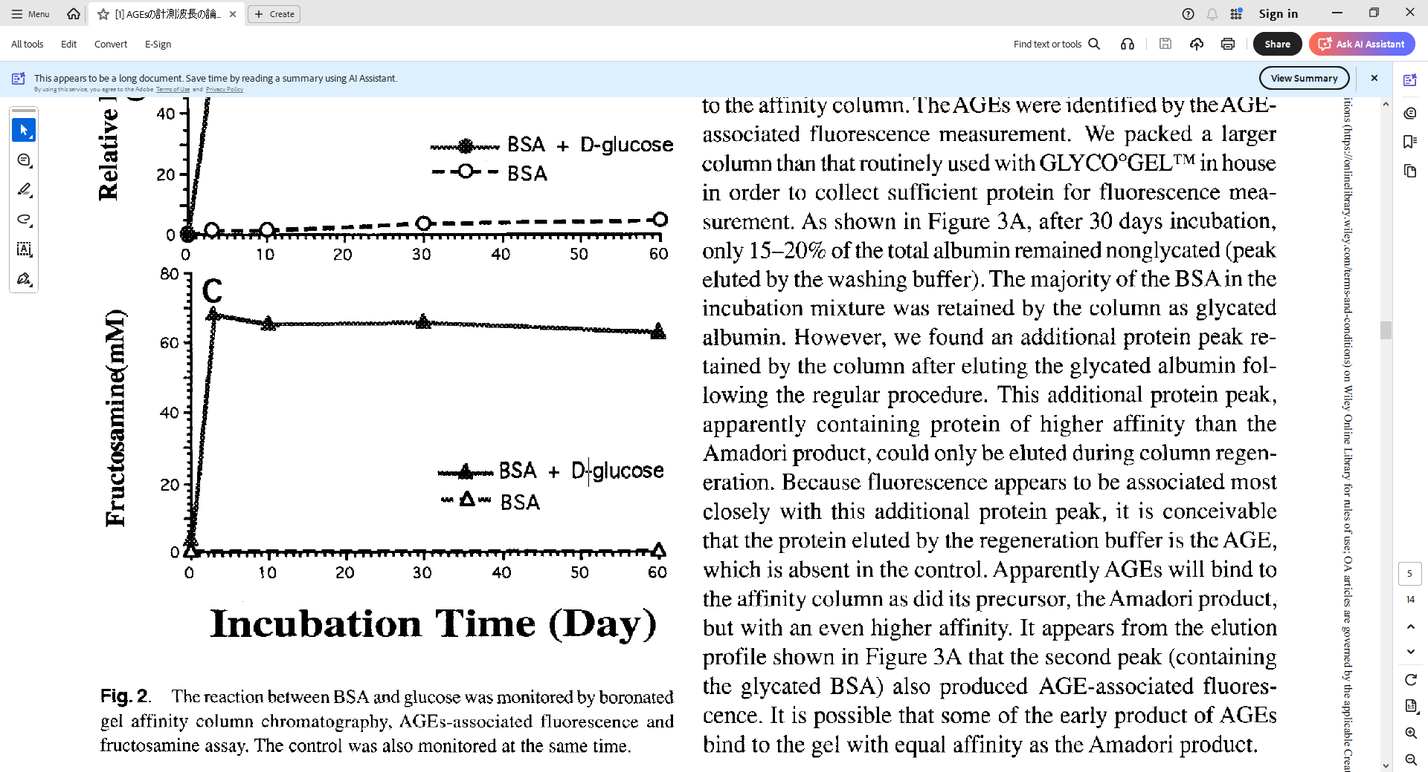
Literature Review
Fructosamine Assay
The purpose of performing this experiment is to quantify early glycation products (Amadori compounds).
The results showed that the fructosamine level rose rapidly in the first 3-4 days and then plateaued.
The fructosamine signal decreased with the increasement of AGE fluorescence.
Fig. Fructosamine level vs incubation time

Slide 7
Literature Review
Chromatographic Techniques
Performed multiple types of chromatography to isolate and characterize AGE fractions.
Boronated Affinity Gel chromatography was performed for selective separation of glycated AGE-modified proteins form nonglycated BSA.
Size-Exclusion chromatography was performed to monitor changes in molecular size and aggregation of BSA during incubation.
Anion-Exchange chromatography was performed to investigate charge changes in glycated proteins.
Chromatofocusing was performed to determine the isoelectric point (pl) distribution of AGE species.

Slide 8
Literature Review
PAGE and SDS-PAGE
Native PAGE (Polyacrylamide Gel Electrophoresis) was performed to monitor the migration pattern changes of BSA bands during incubation, and it indicated heterogeneity in charge and size.
SDS-PAGE was conducted to test if mobility charges came form fragmentation or charge modification, and to smaller fragments are detected.

Slide 9
Literature Review
Aging of proteins: Isolation and identification of a fluorescent chromophore from the reaction of polypeptides with glucose
The primary objective of this paper is to isolate and identify the fluorescent compound responsible for the natural fluorescence observed in proteins reacted with glucose, which is an indicator of nonenzymatic glycation.
The proteins and polypeptides were incubated with glucose and reaction products were purified using gel filtration and high-performance liquid chromatography (HPLC).
The analysis of fluorescent compound was performed by UV-Vis and fluorescence spectroscopy, Nuclear magnetic resonance spectroscopy and mass spectroscopy.
The results identified a specific fluorescent chromophore with excitation at 370 nm and emission at 440 nm, which is the characteristic of AGEs, and demonstrated that this fluorophore forms nonenzymatically.
Also showed that accumulation of such fluorophores contributes to protein aging and fluorescent cross-links in long –lived tissues.

Slide 10
Literature Review
Study of the optical properties of slid tissue phantoms using single and double integrating sphere systems
The primary objective of this paper is to determine the optical properties of the studied solid phantoms by using two calibration models based on measurements adopting integrating sphere systems.
Used both single and double integrating sphere measurement techniques.
The results from the integrating sphere measurement are fed into the calibration models using the multiple polynomial regression method and Newton-Raphson algorithm, and the good agreement between the two models have been observed.
The three different factors that have been studied were titanium dioxide effect as a scatter, black carbon as an absorber and the phantom thickness.
Diffuse reflectance, both diffuse and total transmittance have been measured for all phantoms.

Slide 11
Literature Review
Fig. Single and double integrating sphere setup: single and double integrating sphere aligned in a fixed axis and coupled to the same white light source

Slide 12
Literature Review
Skin Phantoms
Two type of skin phantoms were prepared: one with fixed Titanium dioxide and one with fixed carbon.
Titanium dioxide is a strong scattering of light and black carbon is a strong absorber of light.
Integrating Sphere Systems
Transmittance and reflectance are measured separately by single sphere.
Transmittance and reflectance are measured simultaneously in double sphere, so it can cause less error.
Fig. Imaging setup: Transmitted He-Ne laser intensity from solid phantoms is imaged by a FireWire CCD camera, and suitable power filters are used to produce clear images.

Slide 13
Literature Review
Absorption Coefficient
Absorption coefficient increase when both Titanium dioxide and carbon concentration rise.
It remains stable across all phantom thickness which shows optically uniform phantoms.
When Titanium dioxide increases, photons undergo more multiple scattering events, which make its path longer.
The results showed that for the phantoms with fix carbon and variable Titanium dioxide experienced in gradual rise in absorption coefficient, and those with varied carbon and fixed Titanium dioxide experienced in steeper increasement.
Excellent agreement between the single and double integrating spheres measurements.

Slide 14
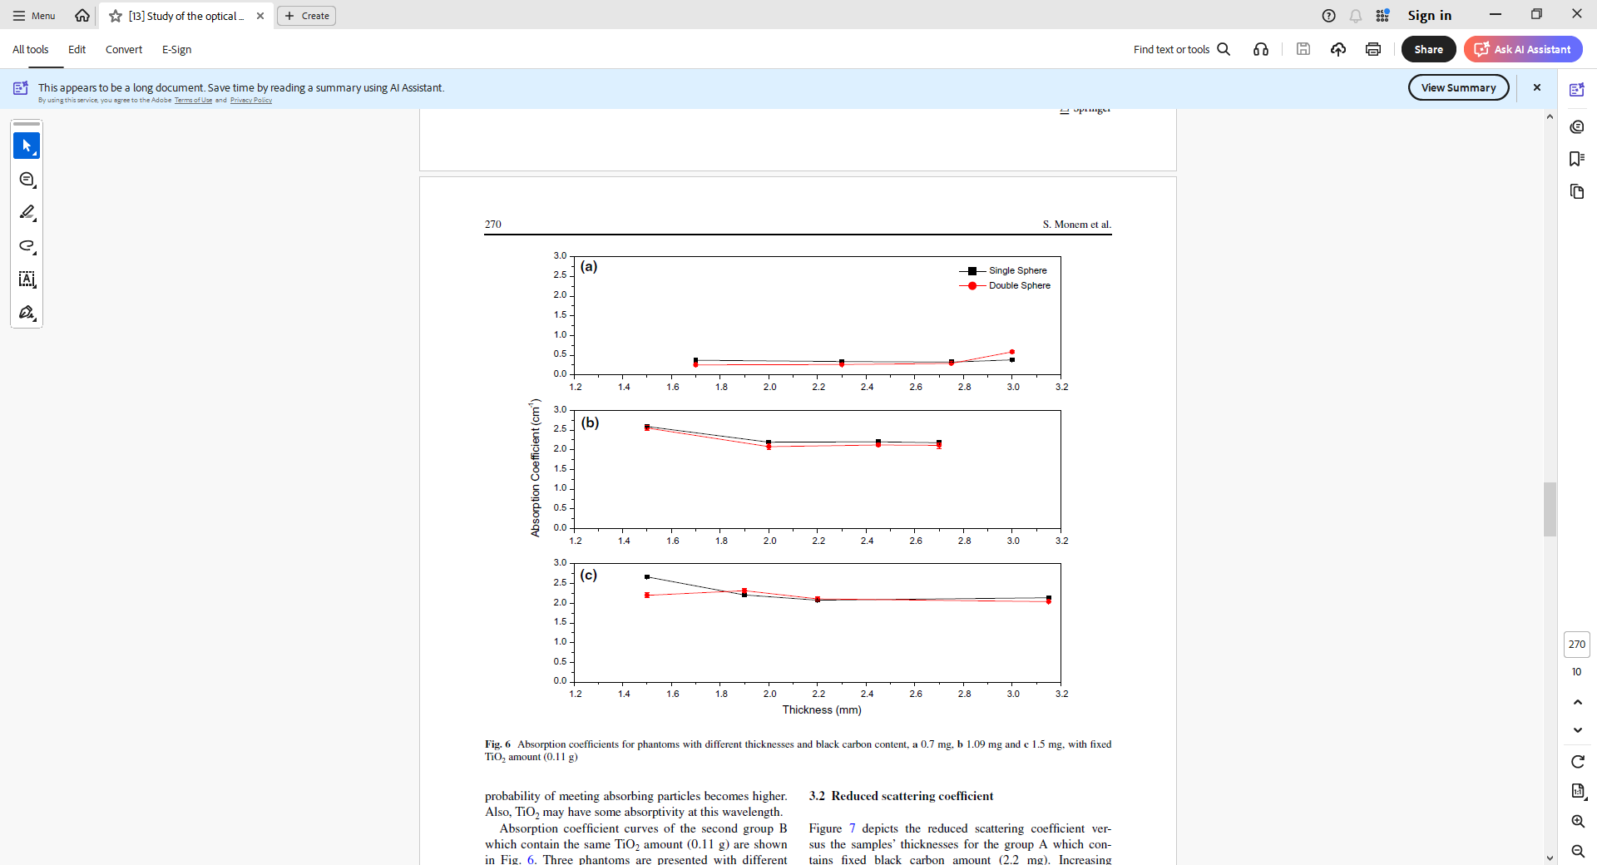
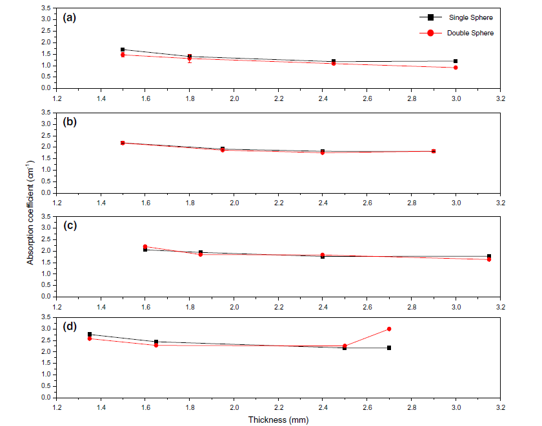
Literature Review
Fig. Absorption coefficient for phantoms with different thickness and black carbon content. a 0.7 mg, b 1.09 mg and c 1.5 mg
Fig. Absorption coefficient for phantoms with different thickness and Titanium dioxide a 0.0 g, b 0.1 g, c 0.155 g and d 0.22 g

Slide 15
Literature Review
Reduced Scattering Coefficient
Reduced scattering coefficient increases proportionally with Titanium dioxide amount.
Also experienced unexpected rise in reduced scattering coefficient with carbon content.
Both single and double integrating sphere produced very close reduced scattering coefficient value.
Titanium dioxide shown strong backscattering as TiO2 particles have high refractive index contrast.

Slide 16
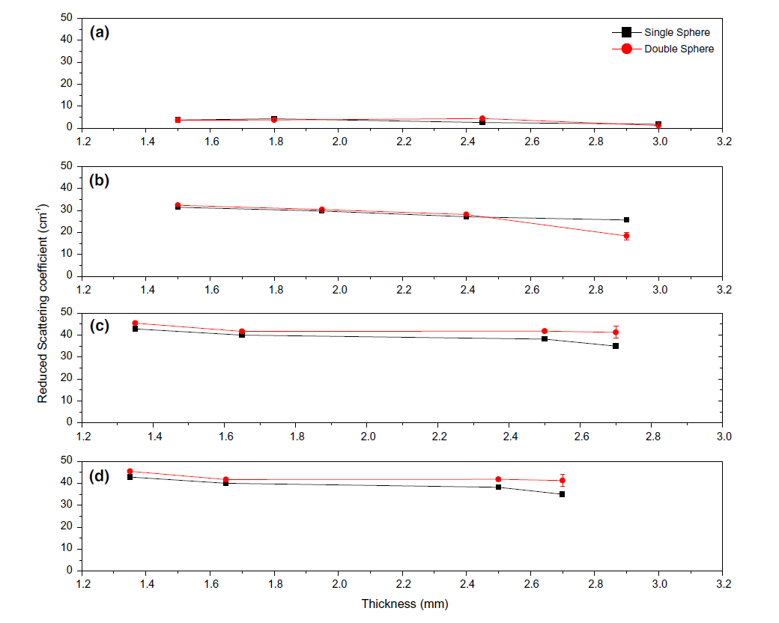
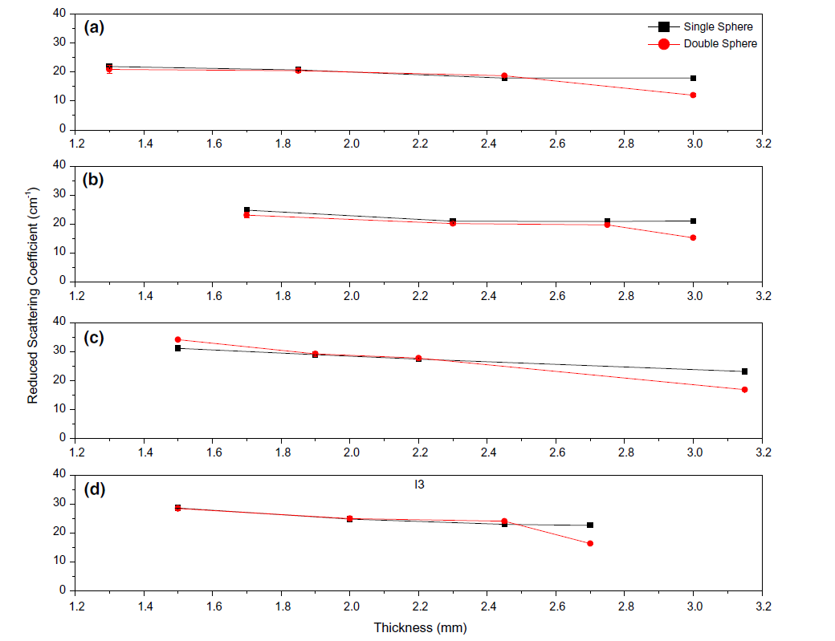
Literature Review
Fig. Reduced scattering coefficient versus the sample’s thickness for the fixed carbon phantoms (2.2 mg) with TiO2. a 0.0 g, b 0.1 g, c 0.155 g and d 0.22 g.
Fig. Reduced scattering coefficient versus the samples’ thickness, the fixed TiO2 amount (0.11g), with black carbon. a 0.0 mg, b 0.7 mg, c 1.09 mg, and d 1.5 mg

Slide 17
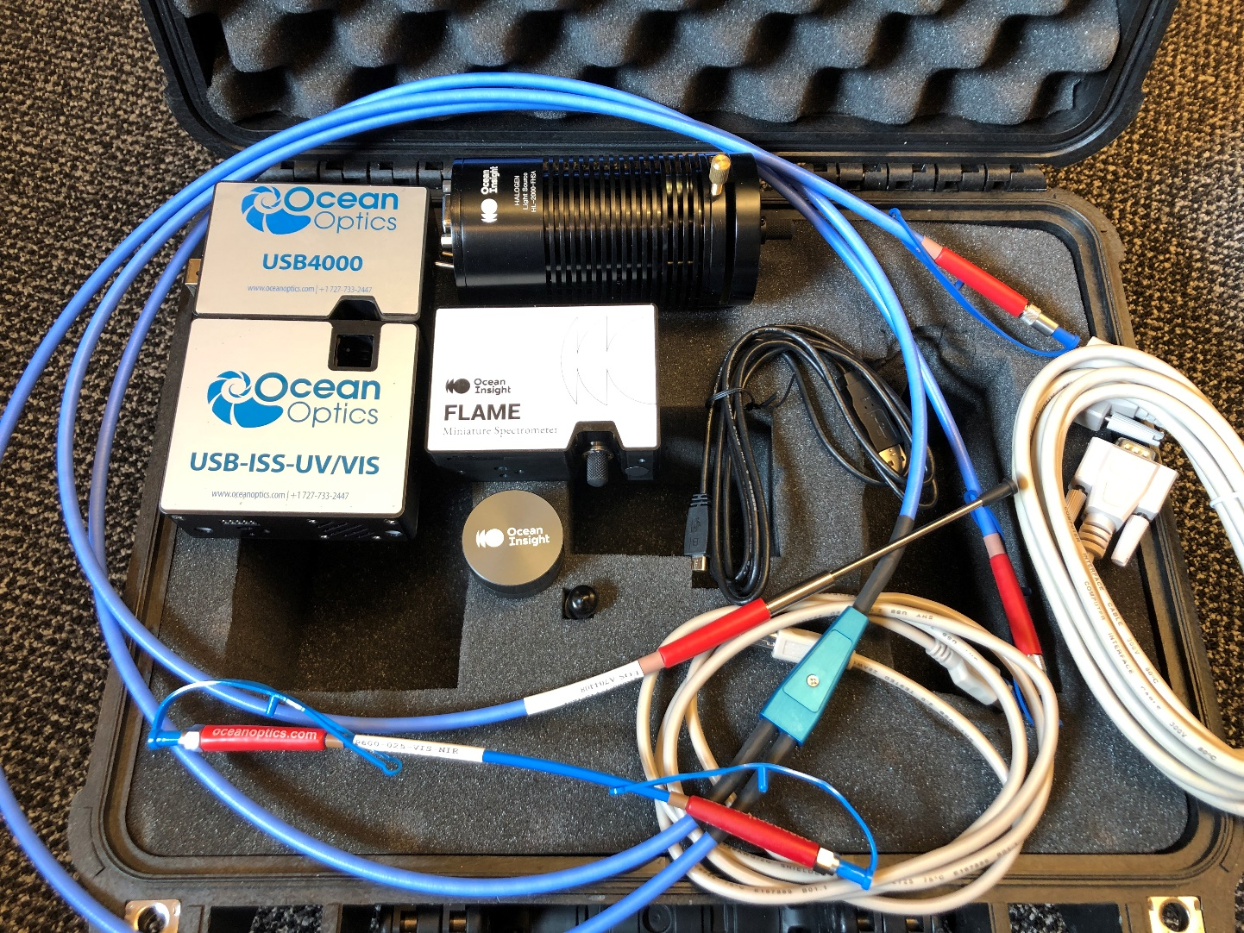
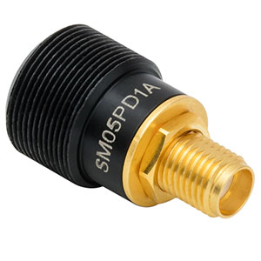
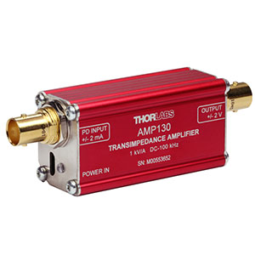
Literature Review
Alternative Photodetector
Fig. Ocean Optic USB4000 and USB-ISS-UV/VIS
Fig. Thorlabs SM05PD1A and AMP130

